Slide 1
Page Rank Algorithms
By: Vedant Gupta(vg374),
Harshal Sinha(hs1030),
Param Amit Shah(ps1169)

Slide 2
Underlying Idea of
Page Rank
A page is important if it is pointed
to by other important pages

Slide 3
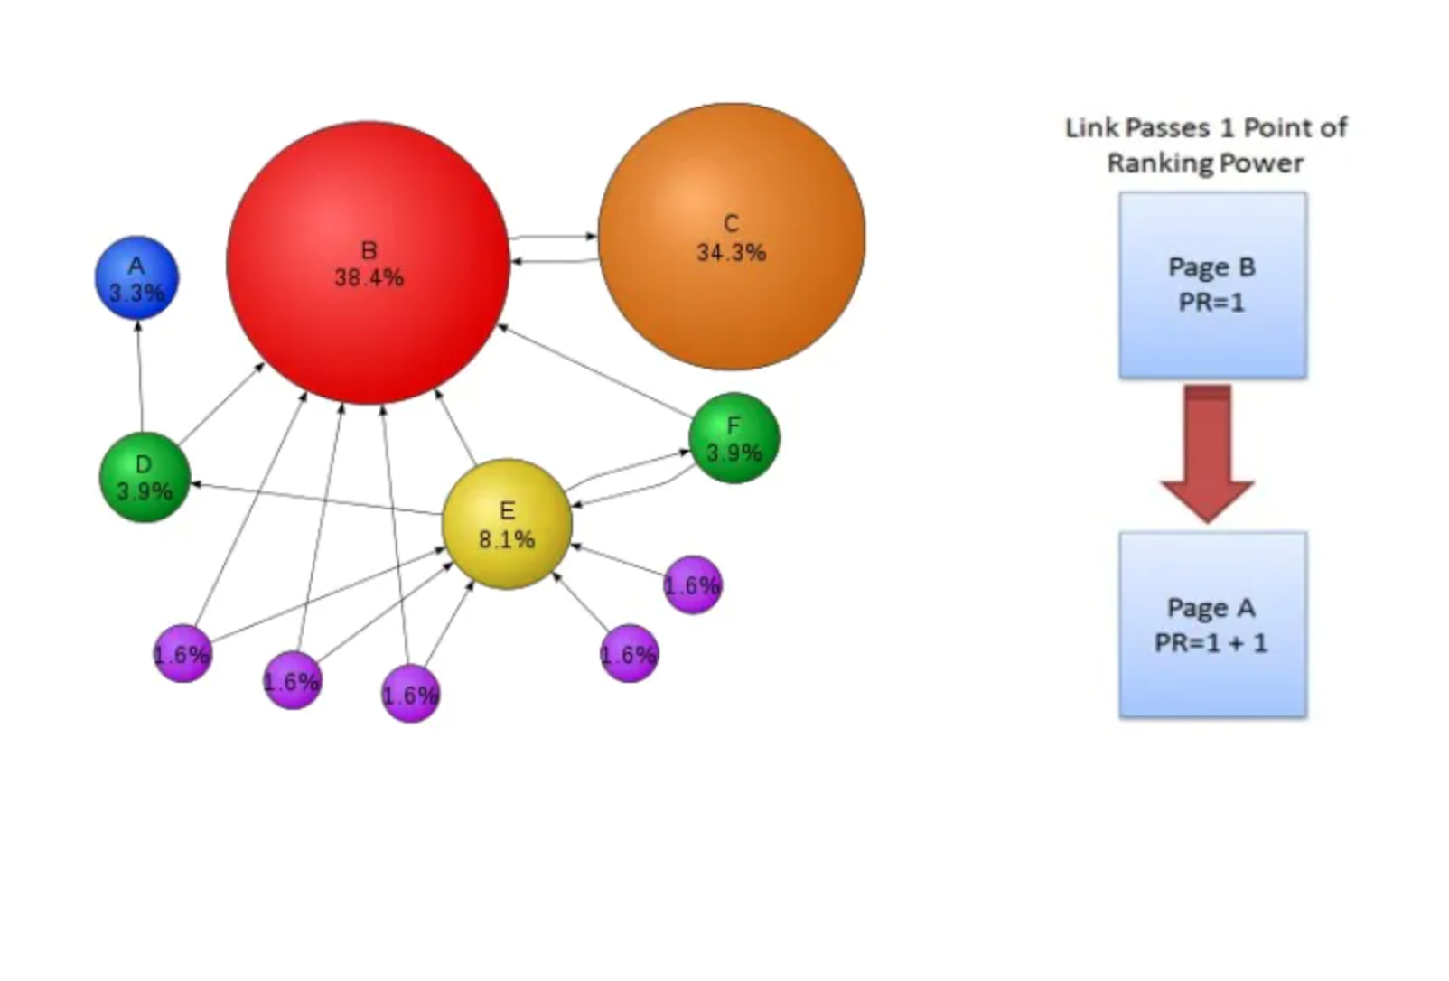

Slide 4
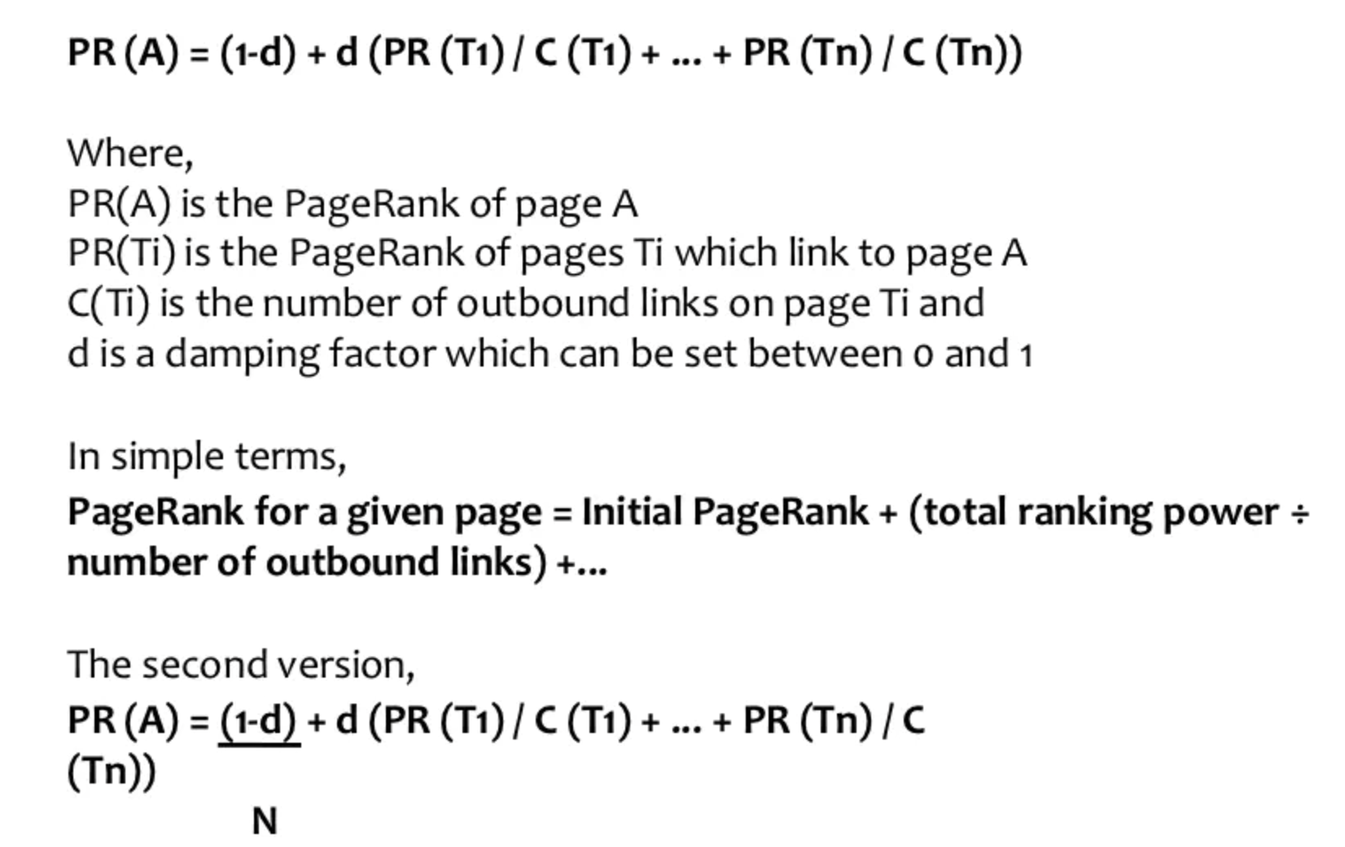

Slide 5
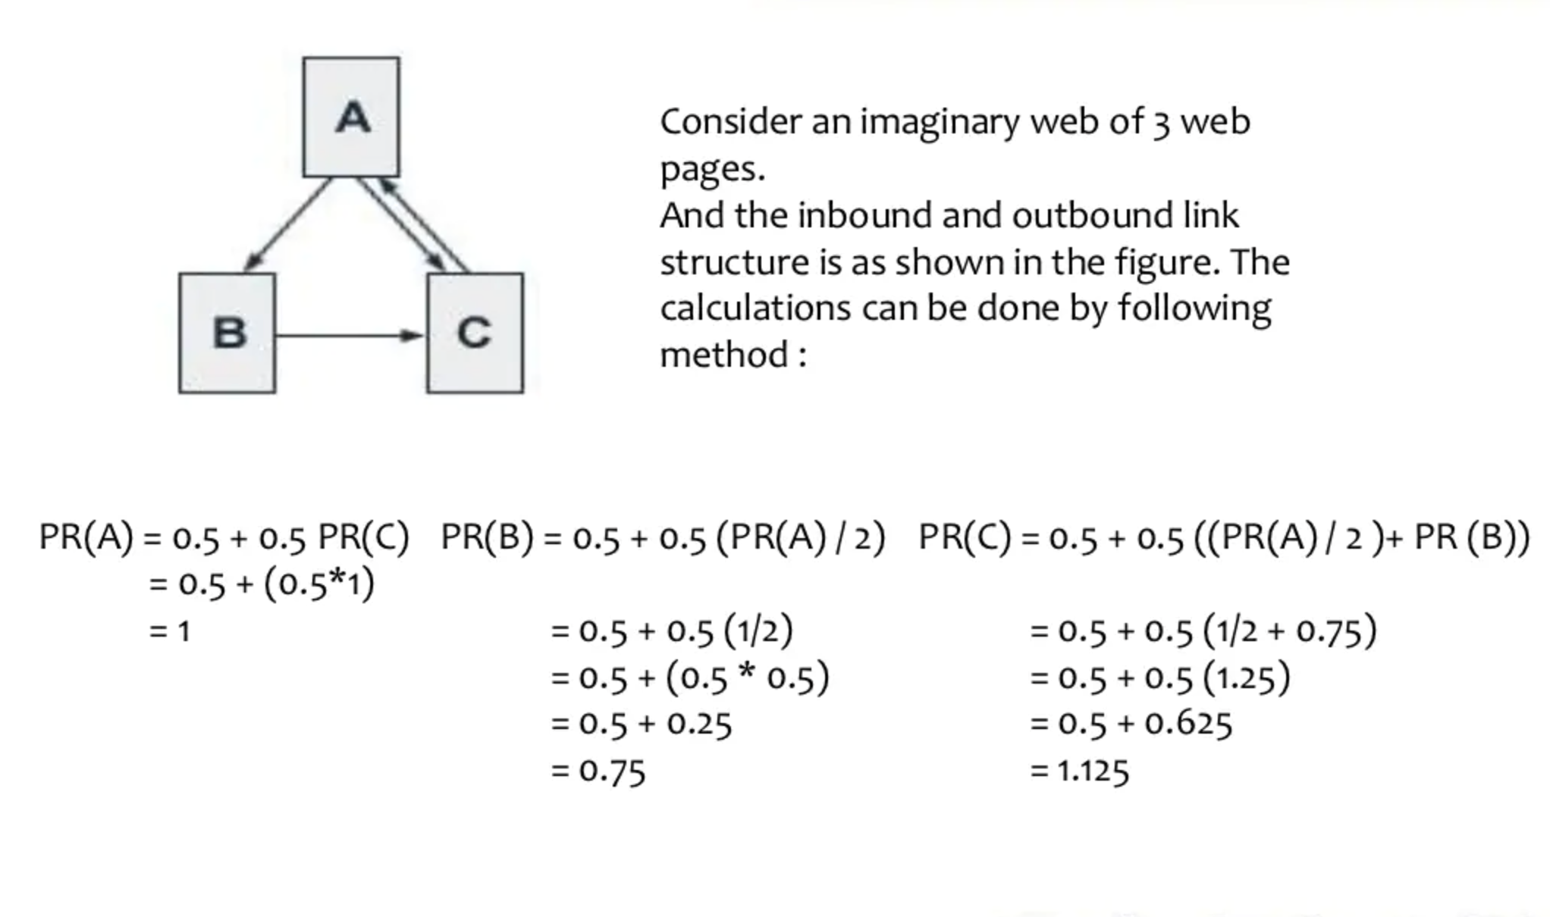
Example of Normal Page Rank Algorithm

Slide 6
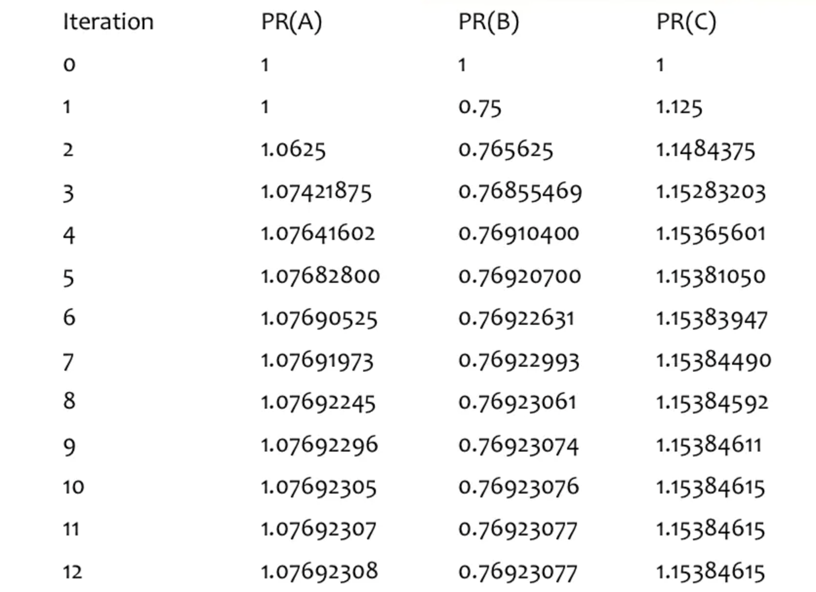

Slide 7
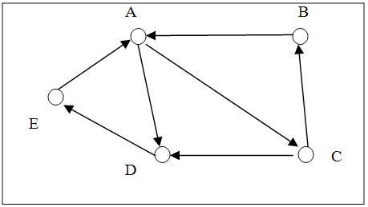
Example of weighted page rank algorithm
Consider the following web page graph, we will apply normal page rank and weight:

Slide 8
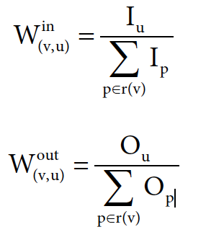
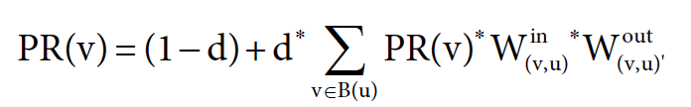
We will use the following formula for the weights:
The formula to compute final page rank is given by:

Slide 9
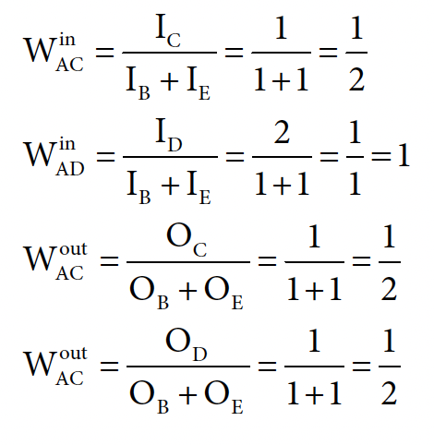
We will now show a few examples of weight_in and weight_out from the graph in page 7.

Slide 10
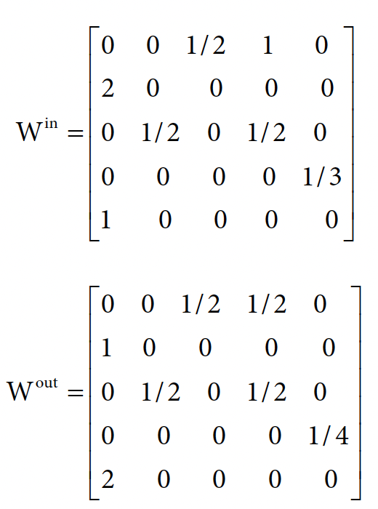
The complete weight_in and weight_out matrix are as follows:

Slide 11
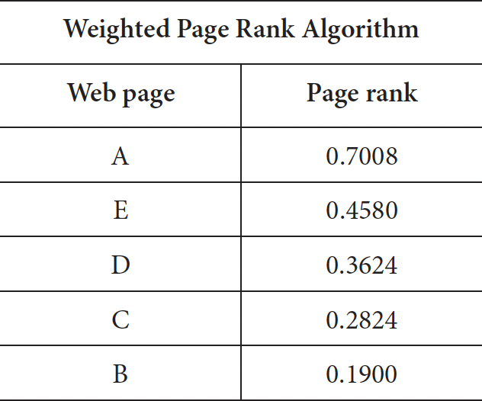
Final output
Using the formula in slide 8, we get the following page ranks for all the pages using d value as 0.85:

Slide 12
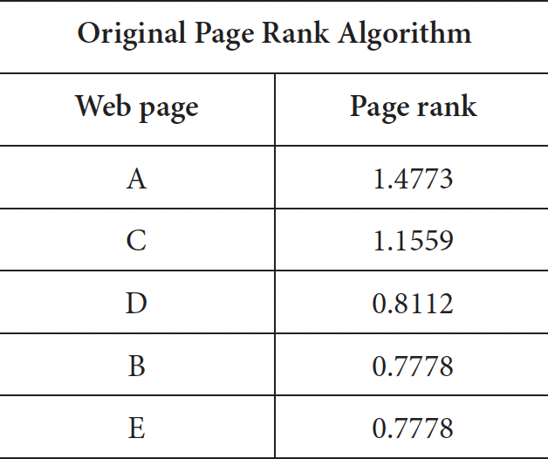
The output of original page rank algorithm:

Slide 13
Conclusion
We can see that the output of weighted method does not produce the same result as the original page rank algorithm, the weighted method is fast but it is inaccurate, so in conclusion when accuracy is very important use the normal page rank method and when time is of the essence use weighted page rank algorithm as it converges faster. The results produced by power iteration and power extrapolation methods for both the methods is same but power extrapolation is much faster in converging in output.

